Slide 1



Financial Aid
Angee Leeds

Slide 2
Financial Aid
Funds provided to student to help pay for postsecondary educational expenses
Free Application for Federal Student Aid is the application to be offered financial aid (must be submitted every year)
www.FAFSA.ed.gov or www.FAFSA.gov
Snapshot of personal & financial information (marriage, number in household/college, income/assets)

Slide 3

FAFSA – 2020/2021
Available online October 1, 2019
Will use 201 tax returns
State deadline: April 15

Slide 4
FSA ID
Use to login & provide electronic signature on FAFSA
  login with financial aid recipients FSA ID
Started 5/10/15 – If you have a PIN, you can link information to FSA ID by entering PIN while registering.
Students & parent will need to have their own ID
  Parents with multiple children use same FSA ID
  Parents completing the FAFSA themselves will use the same FSA ID
Each FSA ID must have unique e-mail address

Slide 5
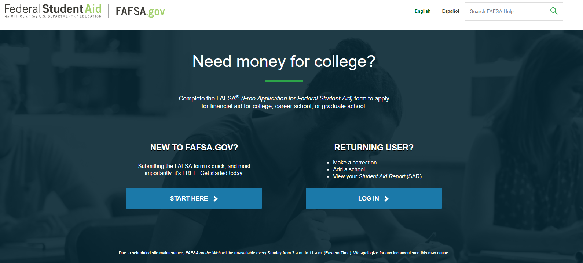
FAFSA & FSA ID Screenshots

Slide 6
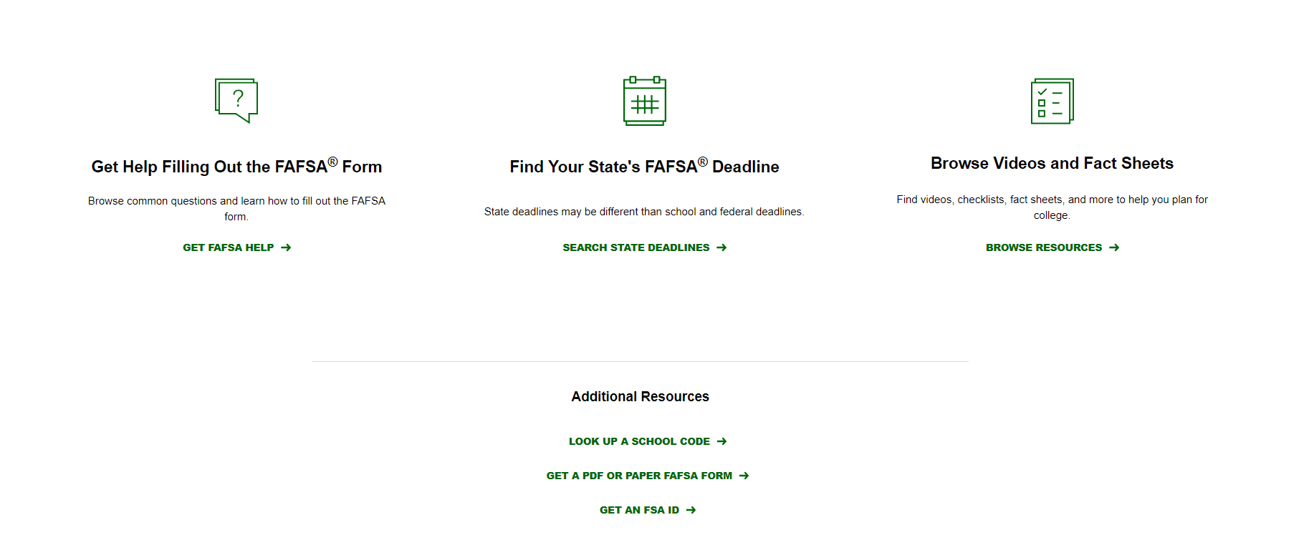
FAFSA & FSA ID Screenshots

Slide 7
Financial Aid Process
FAFSA submitted.
21st Century MUST complete every year even if not attending!
Include accurate email address.
Financial Aid Office requests additional information from student and/or parent(s).
YES
Processor receives FAFSA
Additional information needed?
Requested information received
School receives FAFSA data from processor.
Does not have to be admitted to add school code, but does to be packaged with financial aid
NO
Financial aid file completed and the student is awarded.
Student receives Student Aid Report (SAR) from processor
Notes:
FAFSA stands for “free application for federal student aid”
2 ways to file (if by mail student must contact the federal processer directly to have one mailed to them (make sure to give them plenty of time to make state aid deadline)
SSACI and Federal govt will no longer mail out notifications of awards or that students has rejections so make sure accurate email address is provided

Slide 8
FAFSA Database Checks
Social Security Administration
  Make sure all legalized name changes have been updated
Selective Service
  Gentleman between 18-24 must be registered
  www.sss.gov
National Student Loan Data System (NSLDS)
  www.nslds.ed.gov
If data doesn’t match can cause delays in processing financial aid funds

Slide 9
Cost of Attendance (COA)
Direct & indirect costs
  Direct is billed by or paid directly to college
    Tuition/fees
    On-campus housing
  Indirect are necessary expenses
    Transportation
    Personal care items
Varies from college to college
Puts a cap on the amount of financial aid a student can receive

Slide 10
Estimated Family Contribution (EFC)
Calculated by using federal formula & data from FAFSA
Amount family can be expected to contribute towards COA
Stays same regardless of college
NOT what a student owes the school – is used to determine need based aid
  Examples: $5,576 or lower is Pell eligible & Subsidized Loans

Slide 11
Financial Need
Financial need determines how much financial aid you may receive (and the types of aid)
Need is the difference between the COA & EFC
Will vary based on the cost of different colleges
COA – EFC = Financial Need

Slide 12
Types of Aid
Scholarships – Do not need to be repaid
Grants – Do not need to be repaid
  Awarded based on financial need
Loans – Borrowed money
  ALL FAFSA applicants offered Stafford Direct Loans
Employment
  Work-Study: Students earn a paycheck to help pay educational costs.
    School pays 25% of salary & Government pays 75% and this is why it’s financial aid
  Non-monetary compensation, such as room/board

Slide 13
Enrollment Requirements
Loans (Any):
  Minimum ½ time (6 credit hours for undergraduate & 4 credit hours for graduate)
Pell Grant:
  No requirement, but is pro-rated based on enrollment
State Grants (O’Bannon & 21st Century Scholars)
  Full time (12 credit hours) to receive. 21st Century will pay up to 15 credit hours
Child of a Disabled Veteran (CVO or CDV)
  No enrollment requirement
    MUST have FAFSA on file & remission of fees form submitted to school
Contact financial aid office before making schedule changes!!

Slide 14
Federal Direct Loans
Every applicant of the FAFSA offered
Department of Education is lender
  Servicer will “take over” the loan and will be where payments are made
4.53% interest – FIXED
Does not look at credit
Do not have to accept (if canceled can add back to account as long as enrolled in 6 credits)
  Can reduce or decline
Track at National Student Loan Data System (NSLDS)

Slide 15
Federal Direct Loans
No penalty for early repayment
  Making a payment will not put you into repayment
Loan is students responsibility to repay
  Not parents even though parents income considered
Repayment starts 6 months after enrollment falls below ½ time
Only 1 grace period
If consolidate loans, waives grace period
Must sign a Master Promissory Note & complete Entrance Counseling at studentloans.gov

Slide 16
Federal Direct Loans
Subsidized: Government pays interest while in school
  Based on financial need
Unsubsidized: Interest accrues after awarded
  Receive quarterly statement of interest
  Pay if you can, so you don’t pay interest on interest
  Minimum $2,000 dependent amount
 | Dependent | Independent
Freshman (0-30 CR) | $5,500 | + $4,000
Sophomore (31-60 CR) | $6,500 | + $4,000
Junior (61-90 CR) | $7,500 | + $5,000
Senior (90+ CR) | $7,500 | + $5,000

Slide 17
Parent PLUS Loan
For Dependent students
  Studentloans.gov
  Department of Education is the lender
    Servicer will take over the loan
  Approval: Loan is parents responsibility to repay
  Denial: Allows student additional unsubsidized loans
    Independent loan limit eligibility
    Unsubsidized loan will be students responsibility
  7.08% interest
  Repayment starts 60 days after final disbursement
    Parent can request deferment through lender
  Must sign Master Promissory Note at studentloans.gov
Notes:
Loan Type 2016–17 Interest Rate 2015–16 Interest Rate
Direct Subsidized Loans (Undergraduate) 3.76% 4.29%
Direct Unsubsidized Loans (Undergraduate) 3.76% 4.29%
Direct Unsubsidized Loans (Graduate) 5.31% 5.84%
Direct PLUS Loans (Graduate and Parents) 6.31% 6.84%

Slide 18
Other Loans
Private Loans
  Interest varies based on credit (might need co-signer)
  Flexible repayment
  ASK A LOT OF QUESTIONS

Slide 19
Dependent Students
13 dependency questions – Answer yes to 1 to be independent
  Age, Married, or Dependents
  Veteran
  Orphan or Ward of the Court
  Has an undergraduate degree
  Emancipated as a MINOR (before age of 17) or legal guardianship
    Need documentation
Financial independence does not = independent
Other option is dependency override through school
  If student has no contact with parents
  Student will only use someone else's information as parent (such as grandparents) if there has been a legalized adoption

Slide 20
Whose Information on FAFSA
Applicant
Applicant’s Spouse (if applicable)
If dependent = parent(s) information
  Parents married = both their information
  Parents divorced = Parent student lives with, financially supported by, or the primary parent on divorce decree
    That parent remarried their spouse will be included
Parent/student divorced & filed joint tax return = separate out their income (W2’s), do not include ex-spouses information
Applicant pregnant = unborn baby claim dependent
Not who claims student on tax return

Slide 21
IRS Data Retrieval Tool
Will prefill answers to some questions on FAFSA
Transfers data from federal income tax returns
IRS will authenticate taxpayer's identity
Directed to new window to transfer information
Participation is voluntary
  Improves accuracy
  Can reduce documents later requested by school
Cannot use if married, but filed separately, if there has been a change in marital status of the applicant/parent, student/parent filed a Puerto Rican or foreign tax return, etc.

Slide 22
Special Circumstances
Appeal that allows you to report things that cannot be reported on the FAFSA
  Change in employment status
  Death/divorce
  Medical bills not covered by insurance
  Change in parent marital status
  Unusual dependent care expenses
Complete to increase COA or decrease EFC
Ask financial aid office for appeal form to report this information

Slide 23
Timeline
Complete FAFSA – receive Student Aid Report (SAR)
  There is no other application, offer is automatic
3-5 business days for school to receive information
  If applicant has been admitted.
4-6 weeks for the complete process
Award letter (Financial Aid Notification/FAN) sent
  Generally mail first time & university email rest
Grants/Scholarships will automatically post. Loans must be accepted

Slide 24
Per School
Check award/refund process
  IUPUC awards aid 10 days before first day of classes & refunds are done daily for first two weeks of class
    Make sure to sign up for direct deposit
  Ivy Tech awards/refunds their aid 8 weeks into classes
Check book process
  IUPUC does not have a process to “charge” books, will have to have refund to purchase
  Ivy Tech charges books to accounts because of their late refund period
Check balance process
  IUPUC has payment options, will not withdraw from classes, but has to be paid before next registration
  Ivy Tech will withdraw if there is a balance

Slide 25
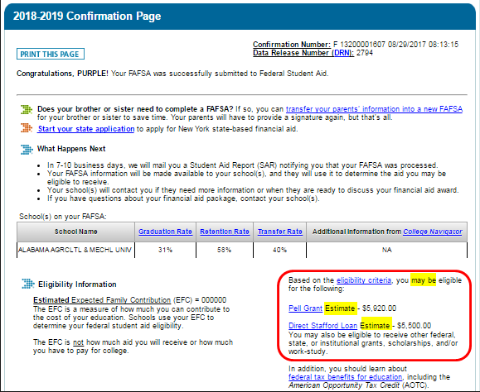
Confirmation

Slide 26
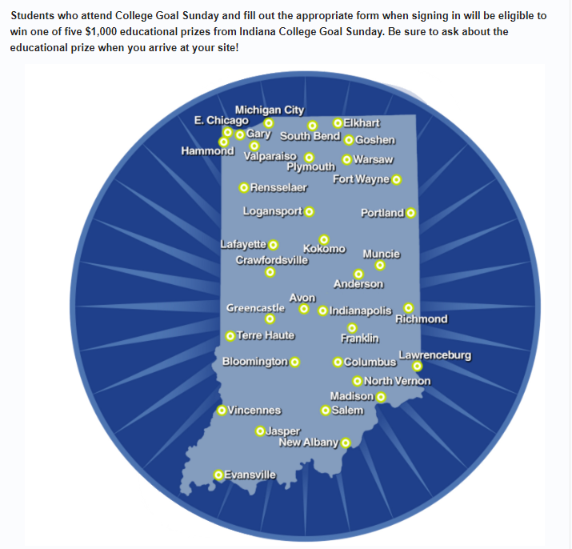
Resources
College Goal Sunday: www.collegegoalsunday.org
  November 3, 2019
  February 23, 2020
  Help filing FAFSA
Track Stafford Loans at National Student Data Loan System (NSLDS): www.nslds.ed.gov

Slide 27
THANK YOU!!!!
Questions
Angee Leeds
  -Financial Aid Representative
Cassie Sutt
  -Student Financial Services Coordinator
financialaid@iupuc.edu
812-348-7231

